Slide 1
Domain & topic of project
Domain – Food & Beverages
Wine Quality data This dataset contains information about red wine.
Ideas would be to find quality of wine and its different attributes affecting the quality.

Slide 2
Introduction
With the help of wine quality data set I will try to find out how the different features impact the quality of red wine. What could be the features which wine maker should take care during manufacturing to make a good quality wine.

Slide 3
Dataset description
This dataset is composed by the following variables:
Fixed Acidity – It is a measurement of the total concentration of titratable acids and free hydrogen ions present in your wine. The most common titratable acids are tartaric, malic, citric and carbonic acid.
These acids, along with many more in smaller quantities, either occur naturally in the grapes or are created through the fermentation process.
Volatile Acidity - Volatile acidity is mostly caused by bacteria in the wine creating acetic acid . This acid that gives vinegar its characteristic flavor and aroma. Volatile acidity could be an indicator of spoilage, or errors in the manufacturing processes caused by things like damaged grapes, wine exposed to air, and so on.
Citric Acid - Citric acid is generally found in very small quantities in wine grapes. It acts as a preservative and is added to wine to increase acidity.
Residual Sugars - RS, refers to any natural grape sugars that are leftover after fermentation ceases. The juice of wine grapes starts out intensely sweet, and fermentation uses up that sugar as the yeasts feast upon it. Yeast typically converts all the sugar into alcohol making a dry wine. However, sometimes not all the sugar is fermented by the yeast, leaving some sweetness leftover.
To make a wine that tastes good, the key is to have a perfect balance between the sweetness and the sourness in the drink.
Chlorides - The amount of chlorides present in a wine is usually an indicator of its saltiness. Too much saltiness is considered undesirable.

Slide 4
Dataset description
This dataset is composed by the following variables:
Free sulfur dioxide & total sulfur dioxide - Sulfur dioxide exists in wine in free and bound forms, and the combinations are referred to as total SO2. It’s the most common preservative used, usually added by wine makers to protect the wine from negative effects of exposure to air and oxygen. It acts as a sanitizing agent adding it usually kills unwanted bacteria or yeast that might enter the wine and spoil its taste and aroma.
Density - It can be used to measure the alcohol concentration in wines. During fermentation, the sugar in the juice is converted into ethanol with carbon dioxide as a waste gas. Monitoring the density during the process allows for optimal control of this conversion step for highest quality wines. Sweeter wines generally have higher densities.
pH - pH stands for power of hydrogen, which is a measurement of the hydrogen ion concentration in the solution. Generally, solutions with a pH value less than 7 are considered acidic, with some of the strongest acids being close to 0. Solutions above 7 are considered alkaline or basic. The pH value of water is 7, as it is neither an acid nor a base.
Sulphates - Sulfates are salts of sulfuric acid. They aren’t involved in wine production, but some beer makers use calcium sulfate — also known as brewers’ gypsum — to correct mineral deficiencies in water during the brewing process. It also adds a bit of a “sharp” taste.
Alcohol - Drinking it in small amounts gives you warm fuzzy feelings inside, and makes you more sociable.

Slide 5
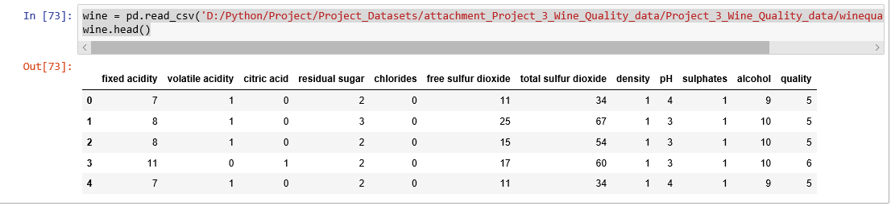
Data preparation

Slide 6
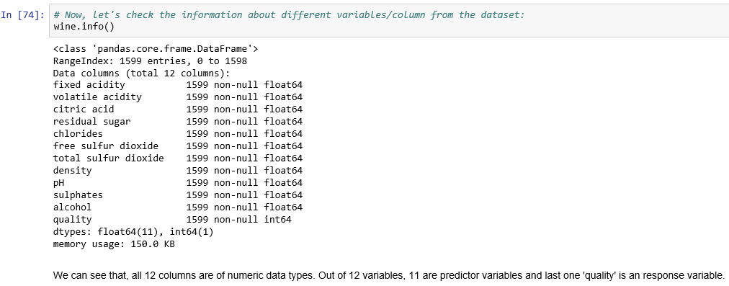
Data Preparation

Slide 7
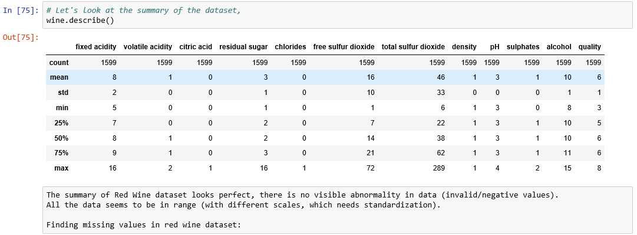
Describe data

Slide 8
Describe data

Slide 9
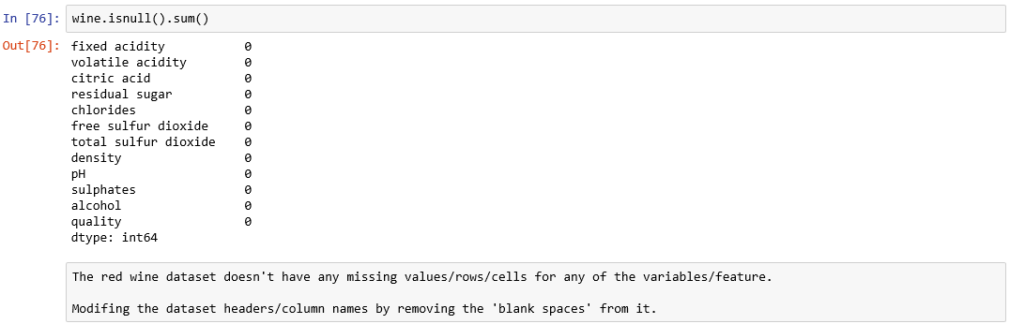
Describe data

Slide 10
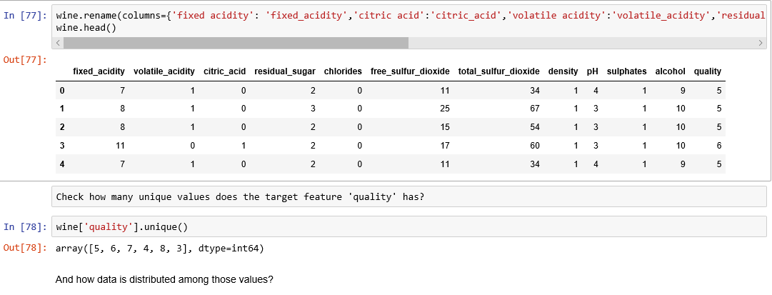
Describe data

Slide 11
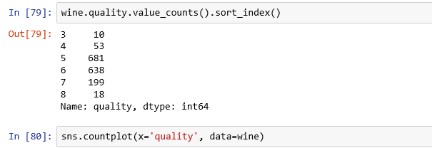
Describe data

Slide 12
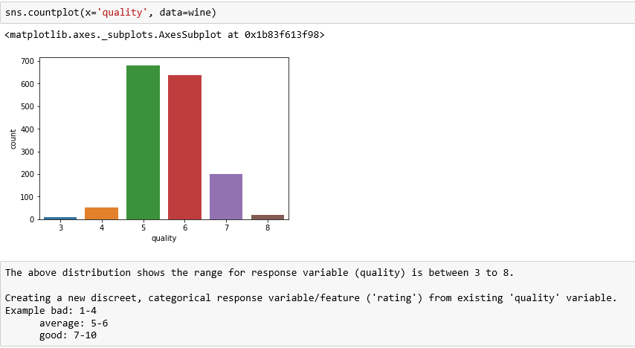
Visualizations

Slide 13
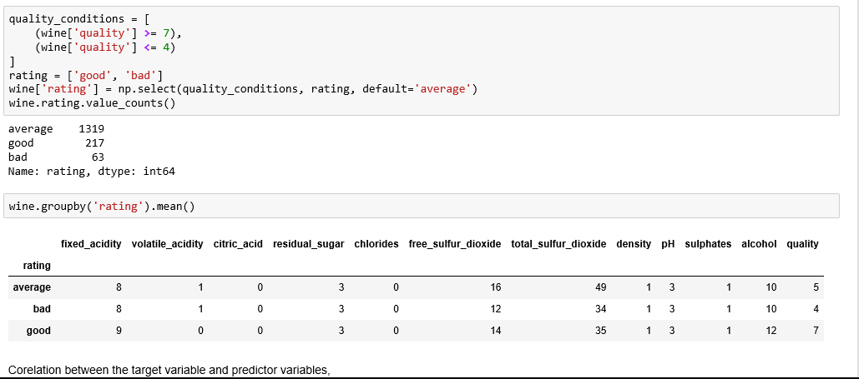
Visualizations

Slide 14
Visualizations

Slide 15
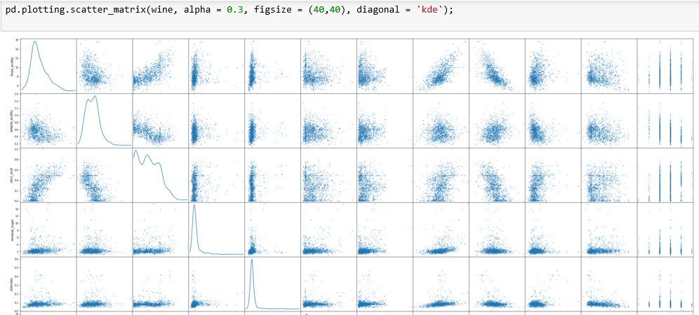
Visualizations

Slide 16
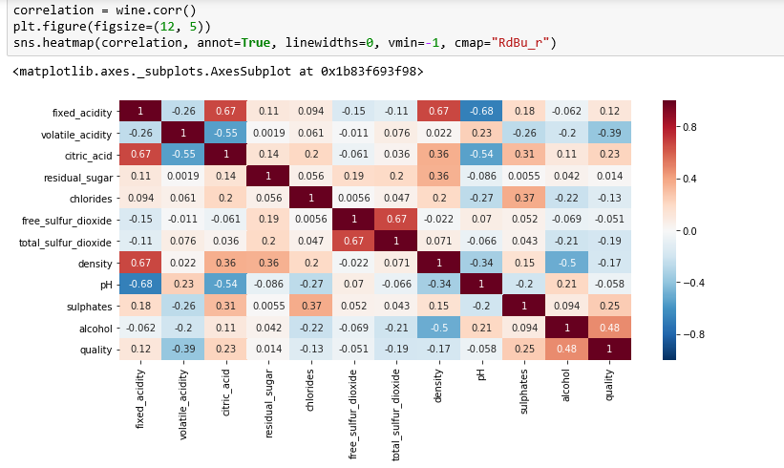
Visualizations

Slide 17
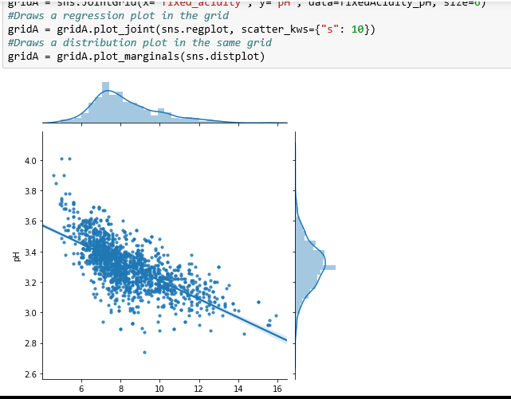
pH vs. Fixed Acidity

Slide 18
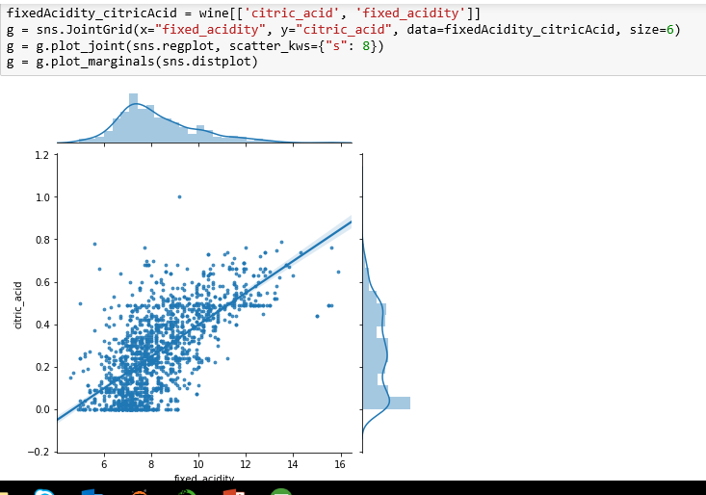
Fixed Acidity vs. Citric Acid

Slide 19
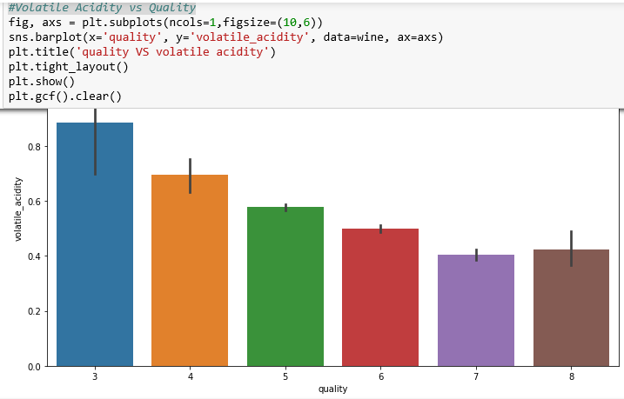
Volatile Acidity vs Quality

Slide 20
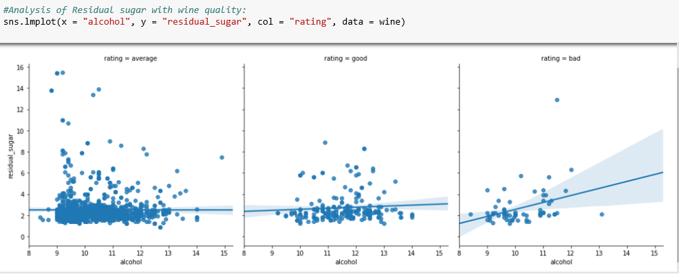
Analysis of Residual sugar with wine quality

Slide 21
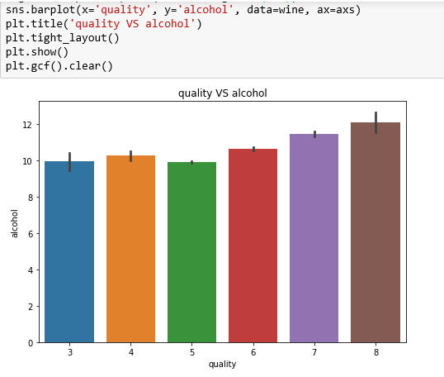
Analysis of alcohol percentage with wine quality

Slide 22
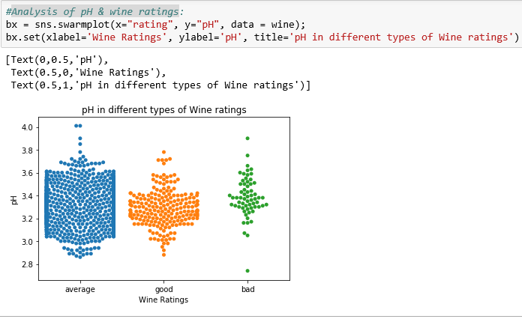
Analysis of pH & wine ratings

Slide 23
Analysis of Citric Acid & wine ratings

Slide 24
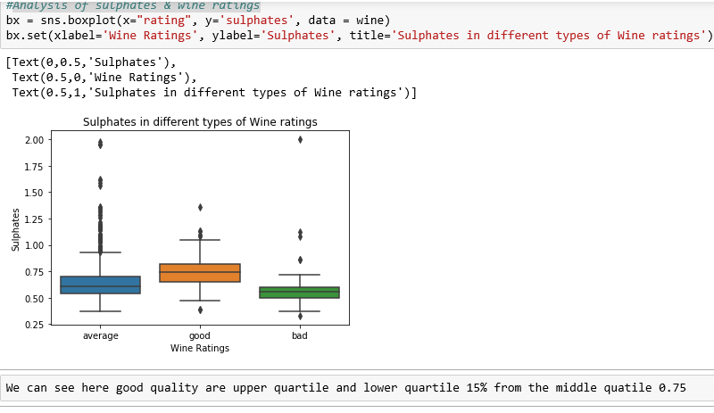
Analysis of sulphates & wine ratings

Slide 25
Analysis of sulphates & wine ratings

Slide 26
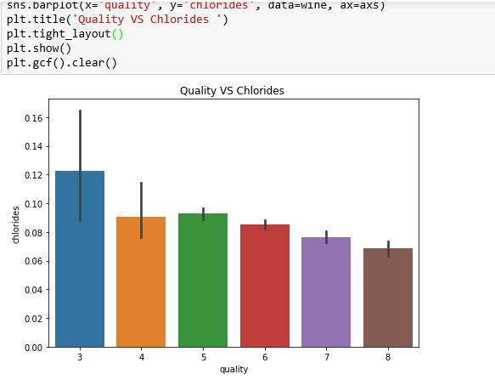
Analysis of quality & wine quality

Slide 27
Thanks !

